Slide 1

COURSE: B.Tech. SEMESTER: Vth (CS B2) By KARTIKEYEA SINGH (1900910100077) Department of Computer Science and Engineering
Mini Project / Internship Assessment
Subject Name: Mini project / Internship Assessment
Subject Code : KCS-554
JSS MAHAVIDYAPEETHA

Slide 2

E-Commerce Shopping Website

Slide 3
Table of contents
Introduction
History
Objective and project goal
Tools and technology used
Feature of the technology used
Societal Relevance and Impact of the Project
Future scope of the project
Screenshots of the project

Slide 4

INTRODUCTION
What is E-Commerce ?
E-Commerce refers to any form of business transaction or buying and selling of products or services via the internet.
It includes-
Online Shopping
Electronic Payments
Internet Banking
Online Ticketing

Slide 5
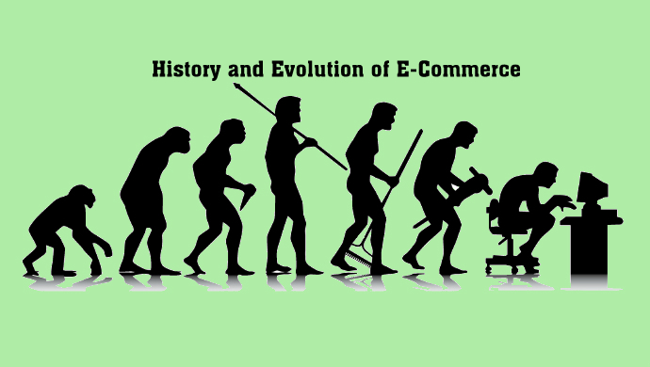
History
The history of ecommerce is closely intertwined with the history of the internet. Online shopping became possible when the internet was opened to the public in 1991.
Online shopping was invented by pioneered in 1979 by entrepreneur Michael Aldrich in the United Kingdom.

Slide 6
Objectives and project goal
Build an e-commerce store to maximize your reach, multiply your business relations to any part of the world, and engage with every user online. With constant communication, you can deepen your relationship with your customer and enhance your brand’s credibility. An e-commerce store will help you target an audience that is genuinely interested in buying your products. Make your e-commerce Website Mobile Responsive
Rank your e-commerce store on Google and showcase your product to a global audience. Build a responsive e-commerce store to present your products more appealingly to attract your customers on both desktop and mobile. A mobile-friendly website will help you earn more traffic to your site. You must opt-in for marketing strategies and tactics that can help you grow your business and set you apart from your competition.

Slide 7
Tools & Technology Used
Sublime Text
HTML (Hyper Text Markup Language)
CSS (Cascading Style Sheets)
JavaScript
Python (using Anaconda Navigator)
Web Search

Slide 8
Features of the technology used
Sublime Text-
Go to anything and any definition.
Multiple selections.
Command palette.
Powerful API and package ecosystem.
Cross platform.
Fast speed and better indentation.
HTML 5-
Video and Audio tags.
It requires less effort to learn and use.
Placeholders.
It is platform independent.

Slide 9
CSS
The framework of a web page is better handled.
It has better device compatibility.
Ability to Re-Position.
Style (CSS) kept separate from structure (HTML), means smaller file size.

Slide 10
JavaScript
Object-Centred Script Language.
Client edge Technology.
Validation of User's Input.
Else and If Statement.
Interpreter Centred.
Ability to perform In Built Function.
Case Sensitive format.
Light Weight and delicate.

Slide 11
Python (using anaconda navigator)
Compiled with latest python release (anaconda).
Python is object oriented language.
It is high level portable language.
New and wide range of packages.

Slide 12
Societal Relevance and Impact of the Project
Pros and Cons Of e-Commerce
Advantages of e-Commerce to Customers
Provide details of the virtual showcase on websites with online catalogs.
Reduced prices due to contests (coupons and offers).
Access and convenience 24 hours.
Provide secure business transactions
It is easier to compare prices with other premium brands
Many options and range (options and options)
Return products if it is of lower quality
Time savings and reviews of easy review.

Slide 13
Advantages of e-Commerce to Business
Increase in potential market share by increasing the customer base
Low barriers to items
Provide safe business and instant transactions
Participate in retail for the launch of new products and services
24/7, 365 days of sales (buyer and seller)
Expanding the scope of the business
Main warehouse administration
Reduction of employee costs

Slide 14
Disadvantages of e-Commerce for Customers
Unable to personally examine the products
Privacy and security in online purchases
Fraud with credit cards
Delays in receiving products
Inability to identify fraud
Guarantee/guarantee
Quality
Hidden cost
Lack of personal interaction
Website fraud.

Slide 15
Disadvantages of e-Commerce to Business
Update hardware and software regularly
Website maintenance at a periodic interval
Additional costs and expertise for electronic commerce infrastructure
The readiness of the site
Training and maintenance Customer loyalty
Outstanding logistics needs
Security and credit card issues
Fraudulent orders
Sufficient internet services

Slide 16
Future Scope of the Project
The future of e-commerce in India is enormous, and the ever-increasing penetration of smartphones will only add impetus to the growth. As the e-commerce industry sees increased traction, it is expected to increase to reach a market size of US$ 188 billion by 2025. The scope of ecommerce has been extended to the next level when dealing online. E Commerce is just buying and selling products online. It includes the online process of developing, marketing, selling and delivering in India has third largest internet population in the world and growing at unprecedented price. In India Cash on Delivery is the preferred buying method, E-commerce creates new opportunities to job seeker.

Slide 17
Screenshots of the project

Slide 18

Website Home Page

Slide 19


Registration and login page

Slide 20
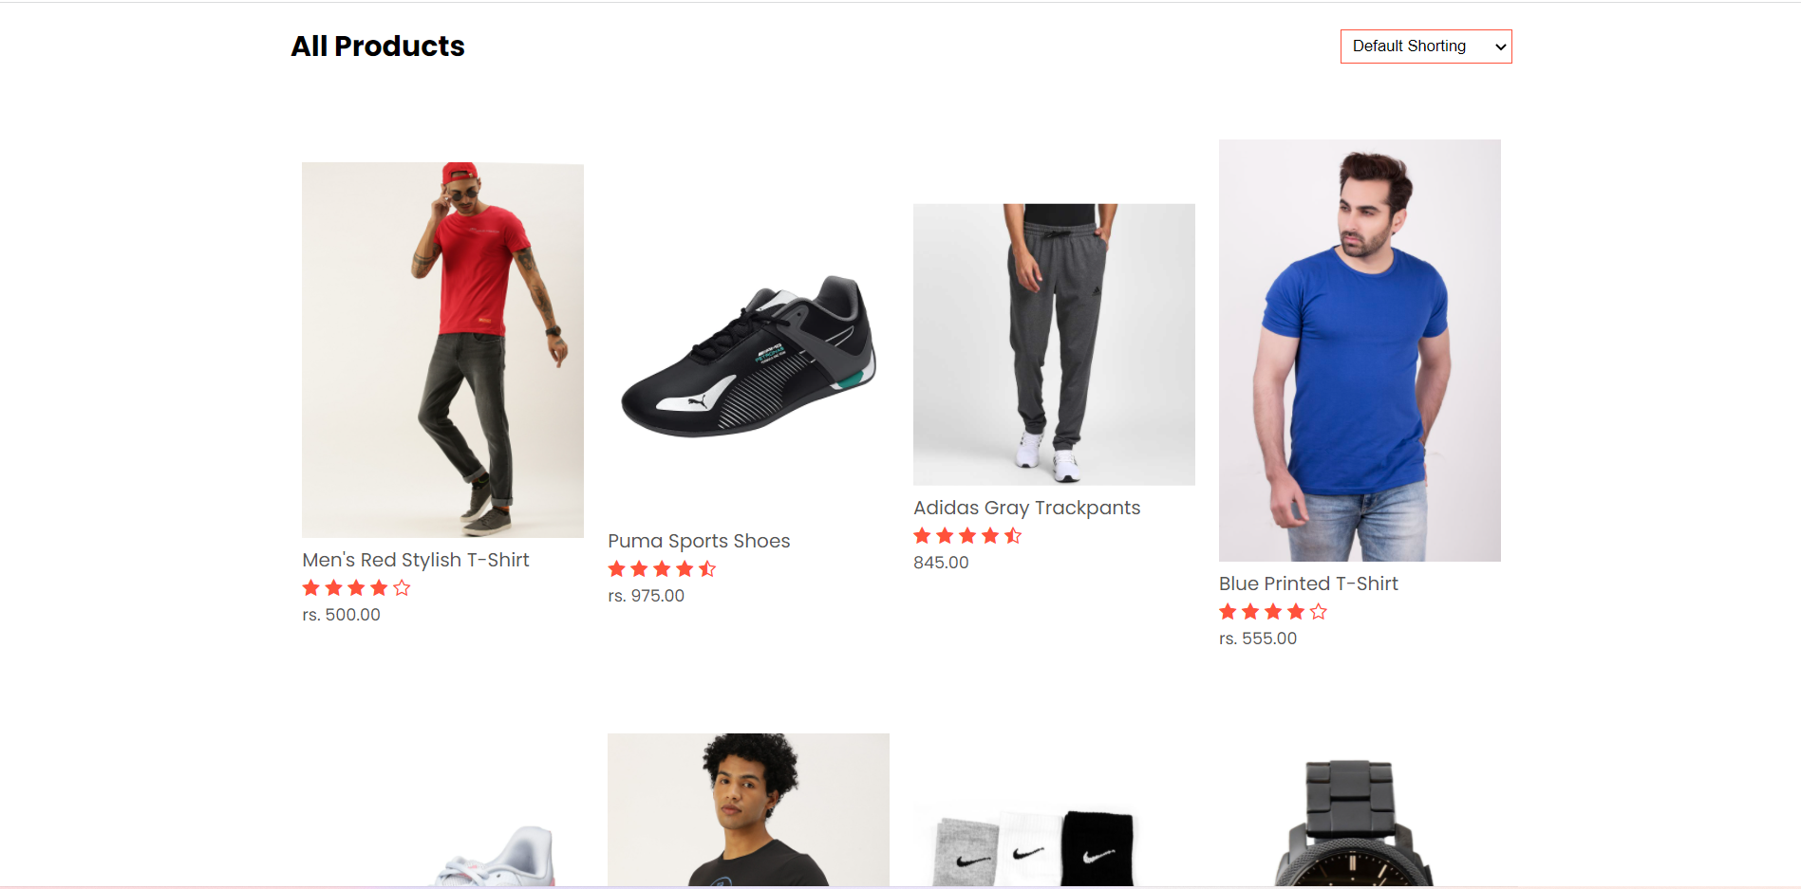
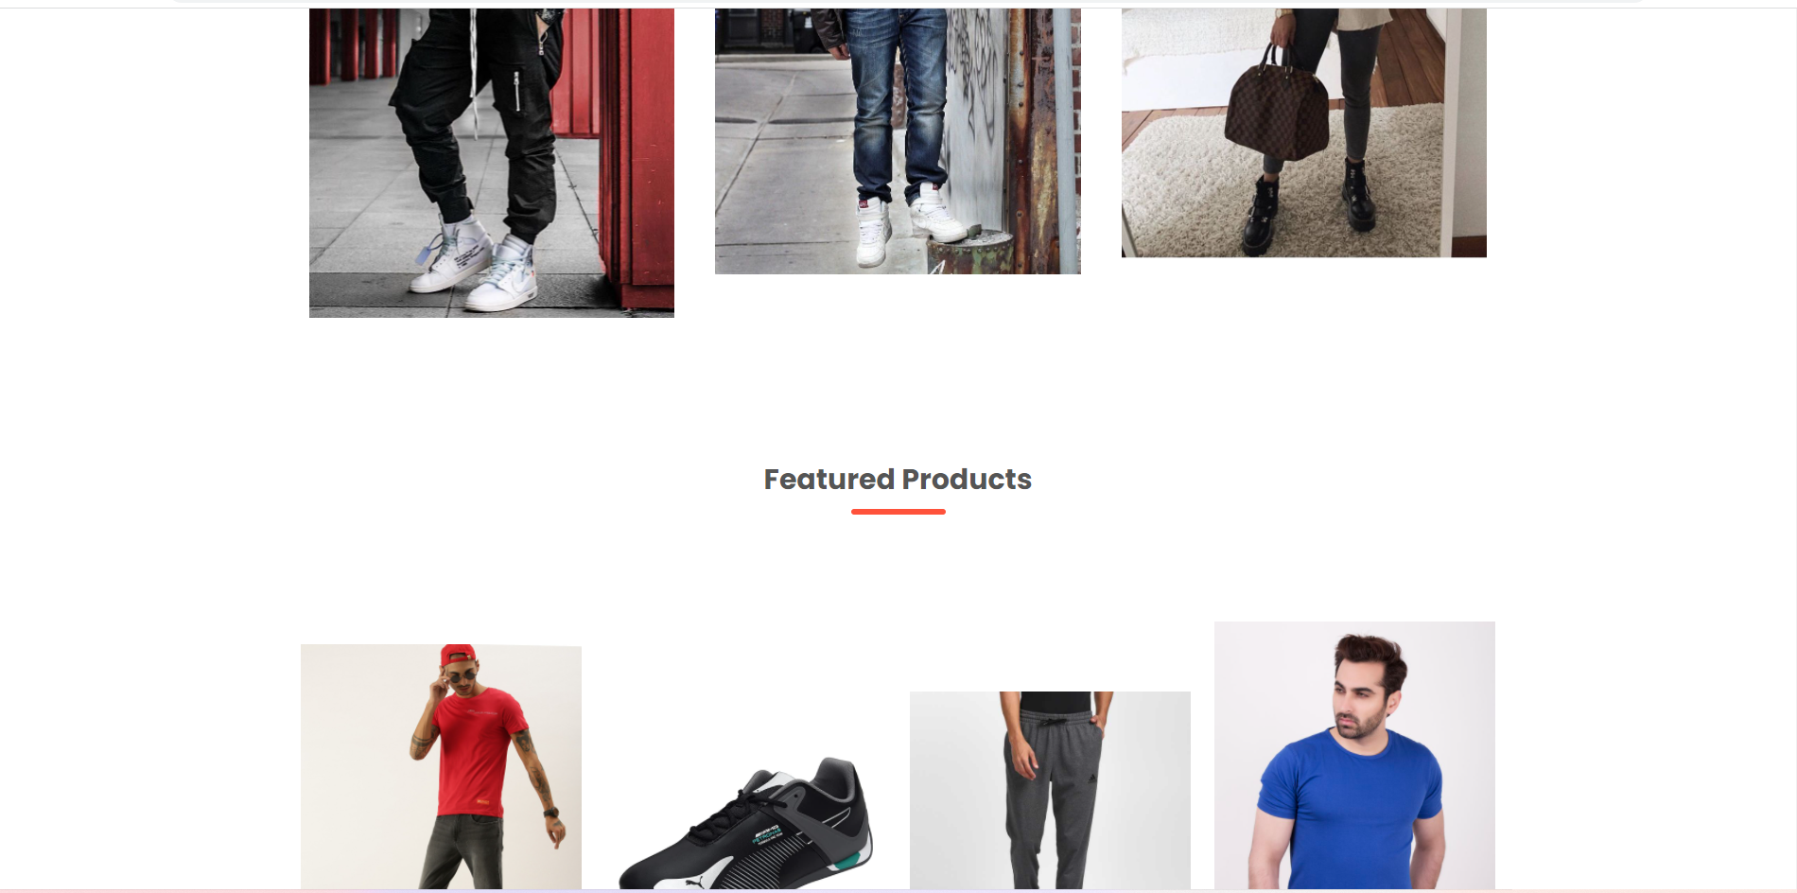
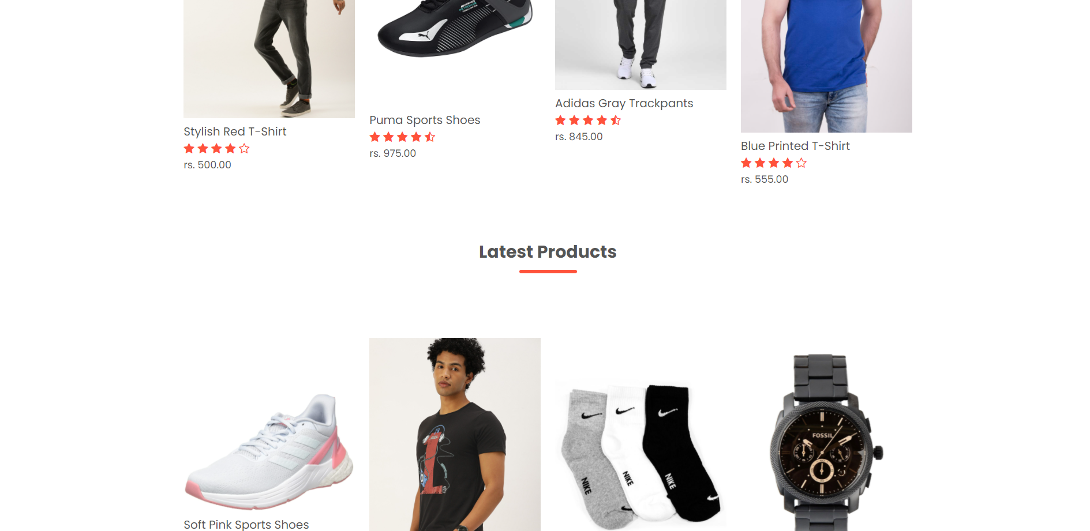
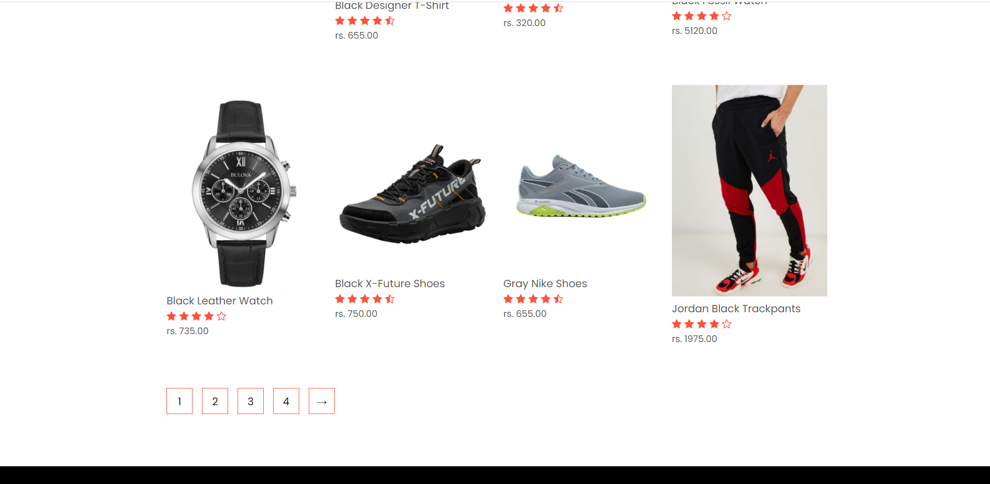
Product page

Slide 21
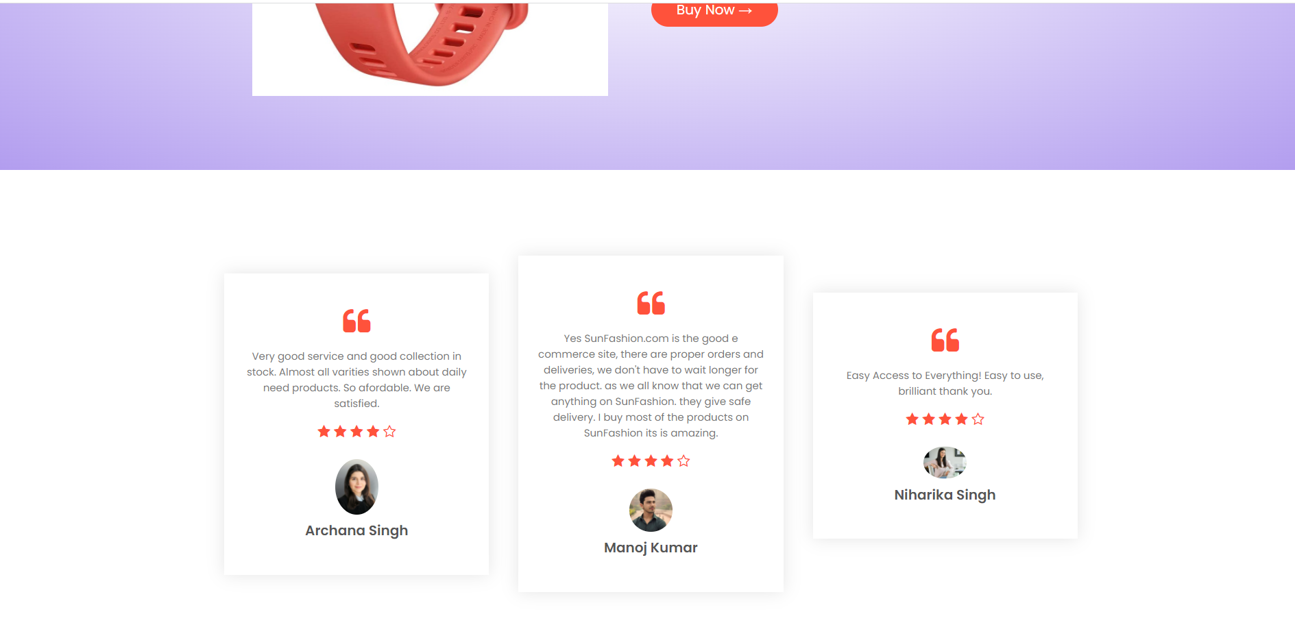
Customer Top Review’s

Slide 22
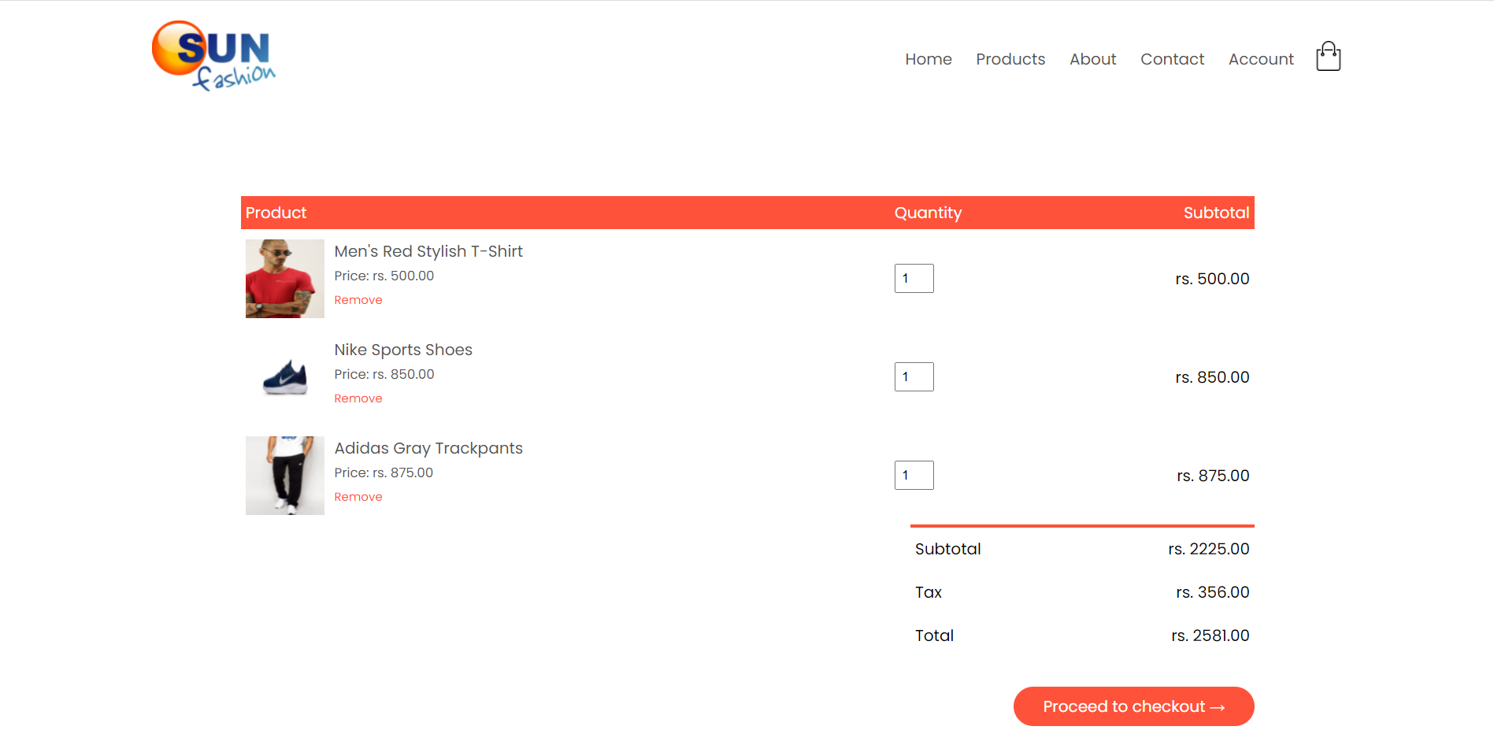
My Cart

Slide 23
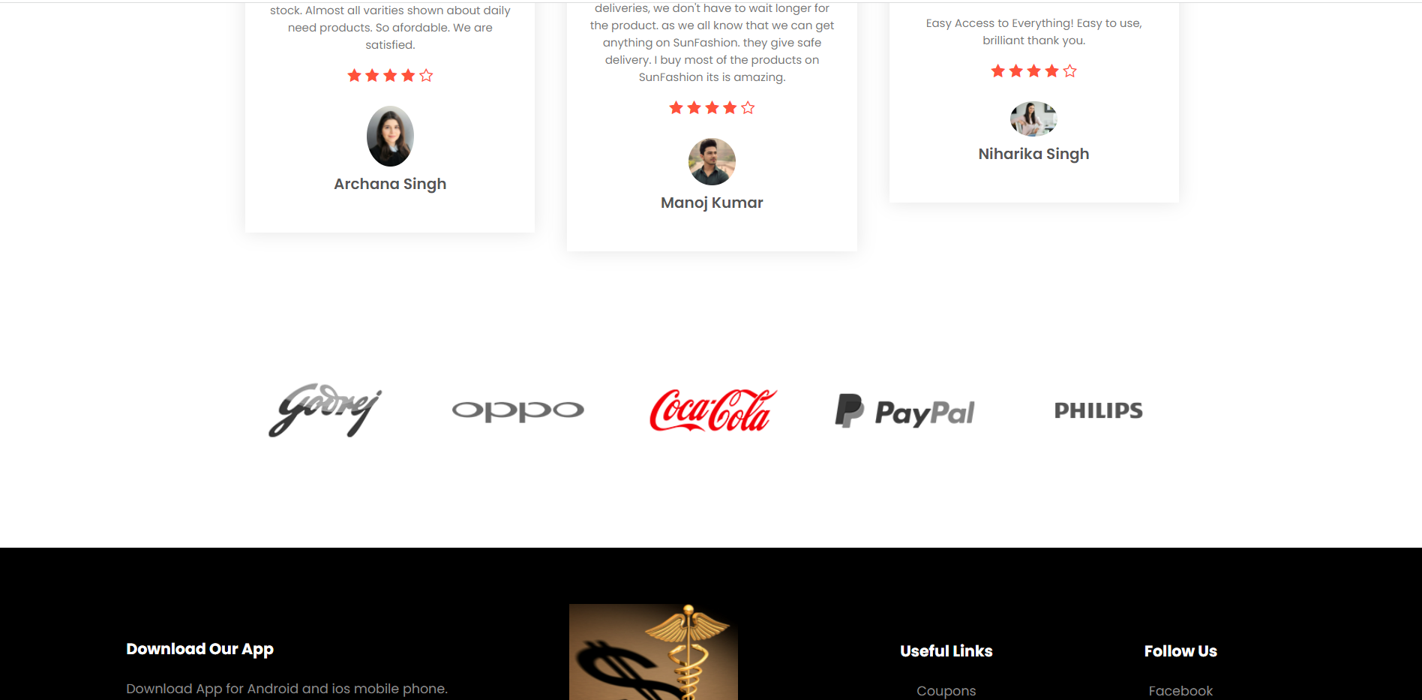
Top Partner’s

Slide 24


